Slide 1
Strategic Store Expansion Using Household Debt Insights
Jennifer Sunmonu • 10.19.2023
Leveraging Data Science for Optimized Store Placement

Slide 2
Agenda
Overview
Impact & Benefits
EDA Insights
Time Series
Next Steps

Slide 3
Project Overview - Recap
Objective: Explore relationship between household debt ratios & Target store placements.
Integration:Combine consumer financial health & Target store locations.
Outcome: Identify patterns to optimize store placements based on financial insights.
Problem Statement: How can debt ratios guide strategic store placement?
Notes:
The primary goal of this project is to understand and harness the potential relationship between household debt ratios in various counties and the strategic placement of Target stores. By integrating datasets that provide insights into consumer financial health, such as the household debt ratio, with Target store locations, we aim to uncover patterns and opportunities for more effective store placements.

Slide 4
Project Updates
Clean and ran EDA on Debt by County Dataset
Ran baseline time series modeling
Evaluated the model
Notes:
The primary goal of this project is to understand and harness the potential relationship between household debt ratios in various counties and the strategic placement of Target stores. By integrating datasets that provide insights into consumer financial health, such as the household debt ratio, with Target store locations, we aim to uncover patterns and opportunities for more effective store placements.

Slide 5
Harnessing Data for Target's Growth
Data-Driven Expansion:
Analyze datasets to gauge regional financial health.
Determine potential locations where Target might excel.
Store Performance Insights:
Review store success* in diverse debt ratio regions.
Detect trends related to regional financial metrics.
Predictive Store Placement:
Employ models to forecast ideal store sites.
Factor in debt ratios, possibly population, competitors, and more.
Implementing Insights:
Strategize upon identifying patterns and predicted locations.
Formulate an actionable plan
.
*A store's success is gauged by whether a remodel has taken place
Notes:
An overview of your proposed vision for tackling the problem using Data Science
Data-Driven Decisions for Expansion:
Analyze multiple datasets to understand regional financial health.
Use this data to inform decisions about where Target stores could thrive.
Pattern Recognition in Store Performance:
Assess current store performance in areas with varying debt ratios.
Identify if regions with certain financial metrics show a trend in store success or challenges.
Predictive Analytics for Store Placement:
Use advanced modeling techniques to predict potential store locations.
Models will consider a combination of household debt ratios and other factors like population density, competitor locations, etc.
Strategic Implementation of Insights:
Once patterns are identified and potential locations are predicted, formulate an actionable plan.
This plan could include steps for securing store locations, marketing strategies tailored to the financial health of the region, and more.

Slide 6
Impact & Benefits
Informed Strategic Decisions: Prioritize regions for expansion/remodeling based on concrete financial indicators, not just intuition.
Increased Store Success Rate: By correlating remodeling events with household income trends, optimize store locations for better performance and longevity.
Cost Efficiency: Reduce the risk of investing in locations with unfavorable financial conditions. Allocate resources more effectively.
Future Store Performance Predictions:Understand the timing of store openings and remodels against financial metrics, enabling the prediction of future successful store locations.
Maximized ROI: By aligning store strategies with regional financial insights, ensure a higher return on investment and sustained store success.

Slide 7
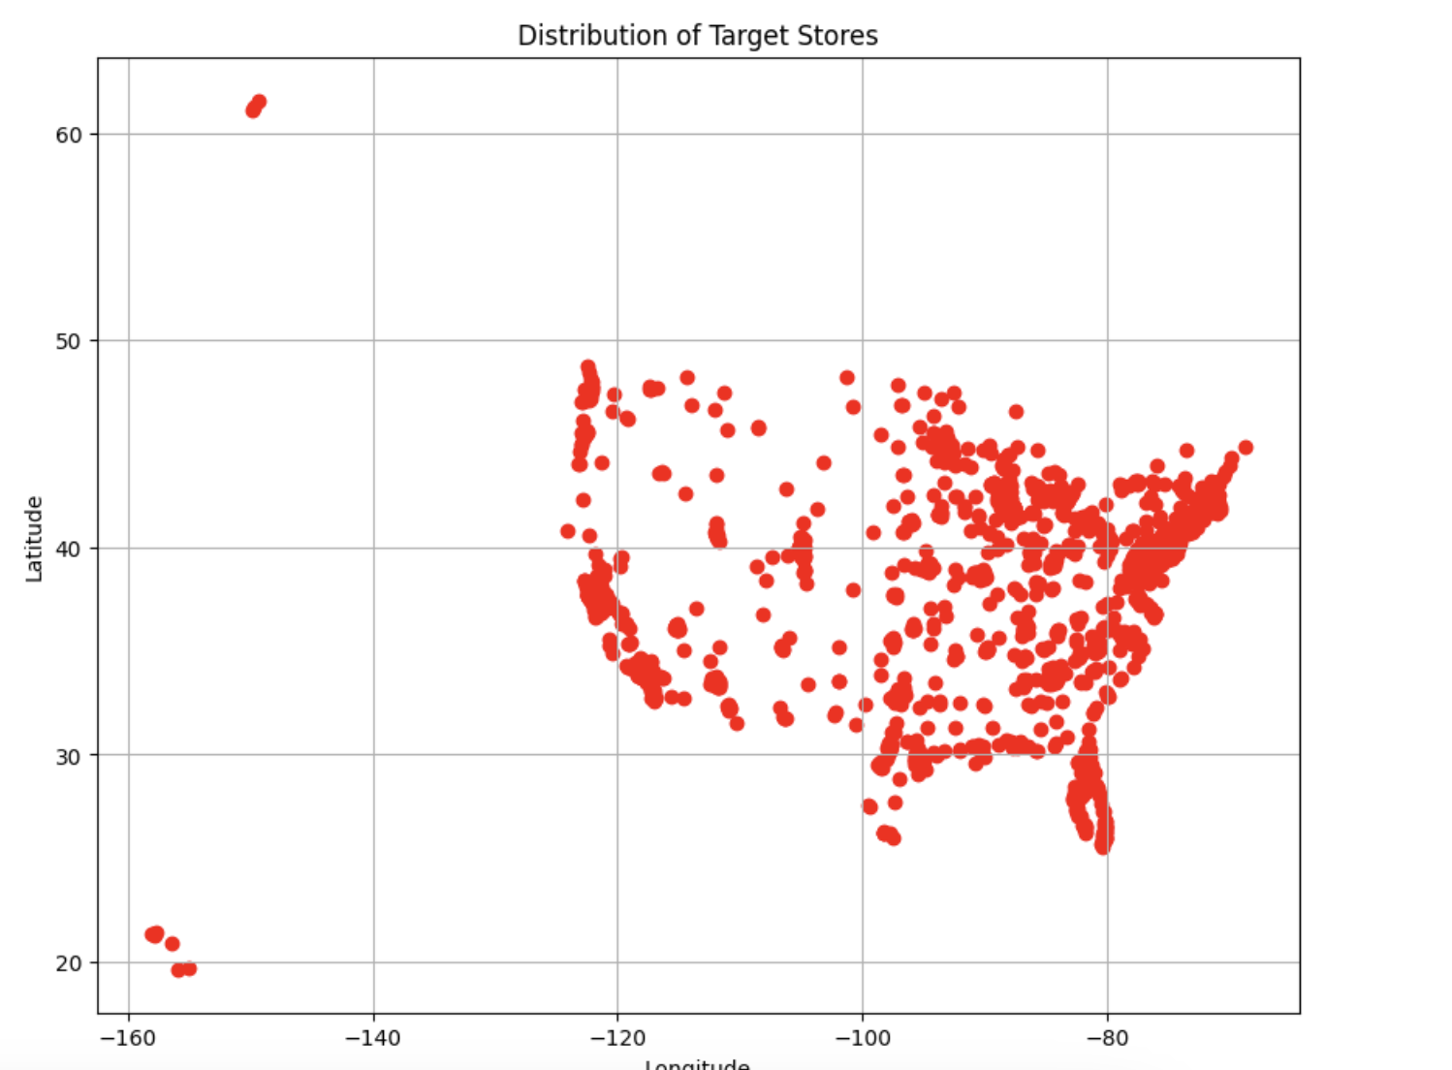
A Peek into The Data
Target Store Data:
Features:
Store Locations (Latitude, Longitude)
Remodeling Events
Store Open Dates (1969)
One Hot Encoded Features
Initial Insights
Collinearity on Remodel & Features
Notes:
Converted dates,
One hn

Slide 8
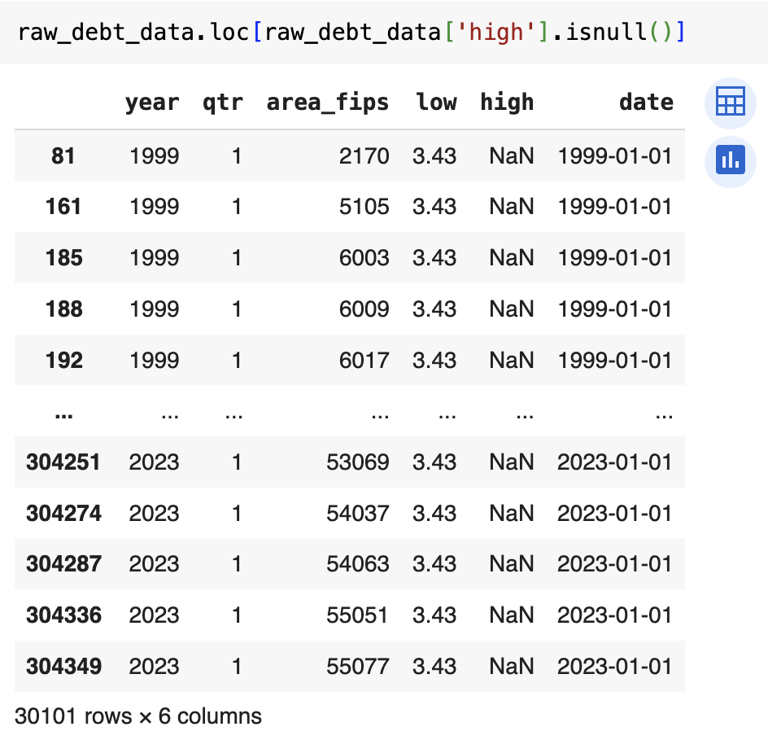
A Peek into The Data
Household Debt Data:
Features:
Year
Quarter
County
Debt-to-Income Ratio
Key Data Quality Concerns:
Some records have incomplete data entries.
Need to convert FIPS codes to actual county names for clearer interpretation.
Notes:
Converted dates,
One hn

Slide 9
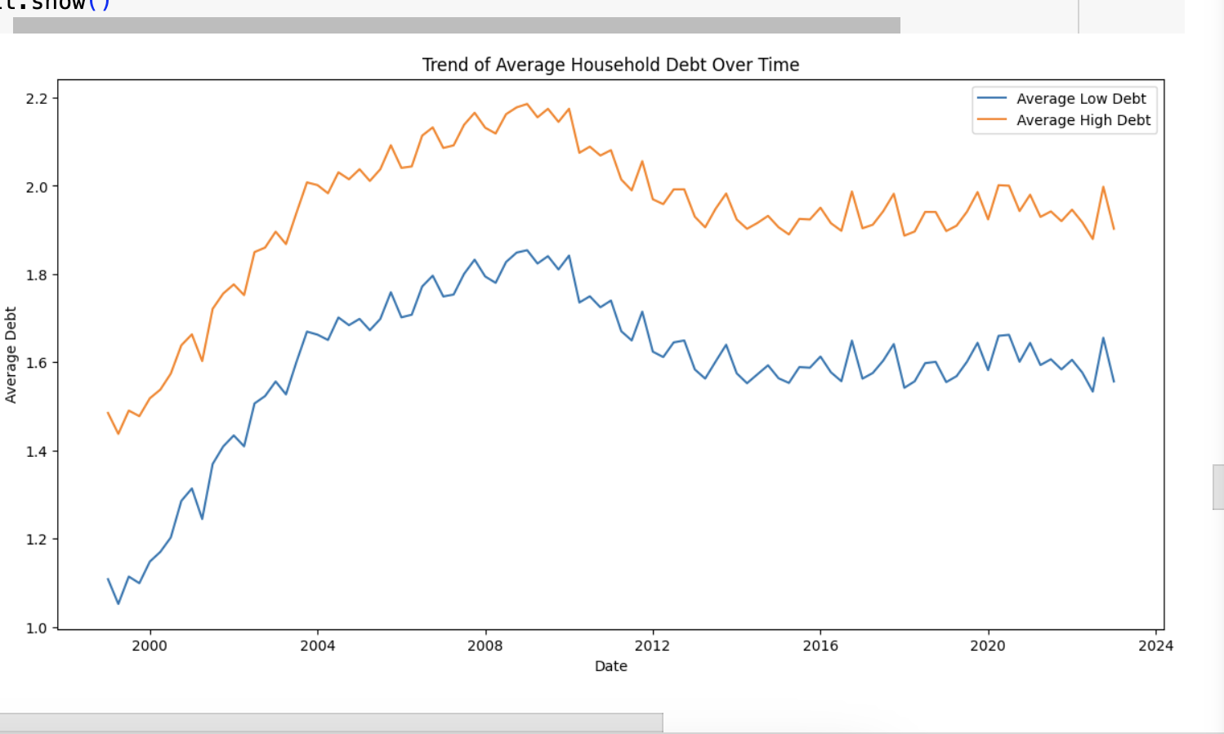
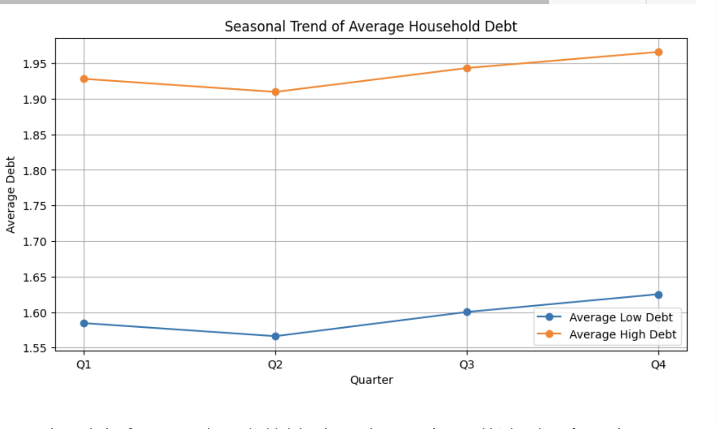
Preliminary Insights
Seasonality:
Trend Analysis:
Notes:
The trend plot shows the average low and high household debt values over time. Both series appear to follow a similar trend, which is expected given that the high values were filled using the low values for missing entries.
The seasonal trend plot for average household debt shows the mean low and high values for each quarter. There doesn't appear to be significant fluctuations between quarters, suggesting that there may not be strong seasonality present in this aspect of the data

Slide 10
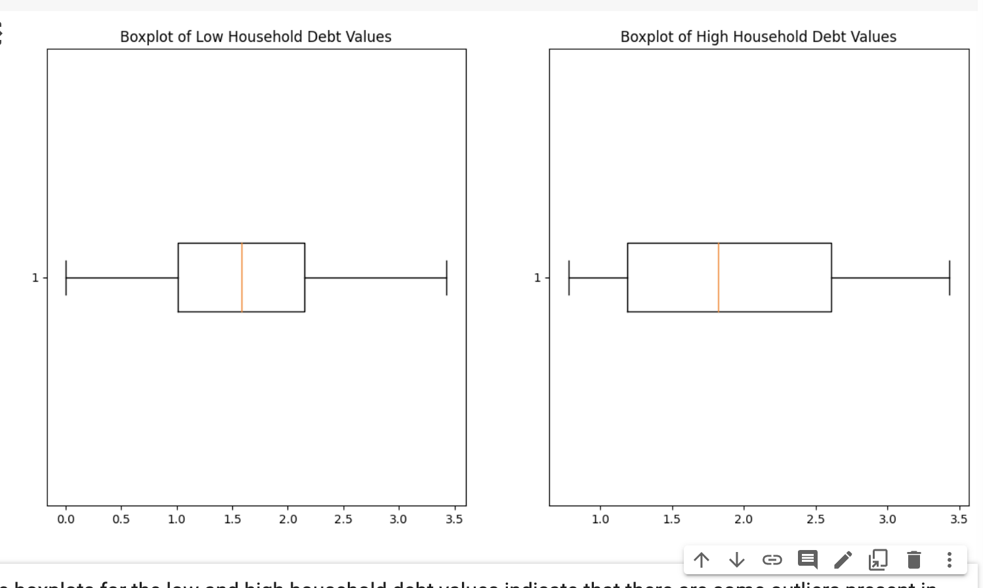
Preliminary Insights

Slide 11
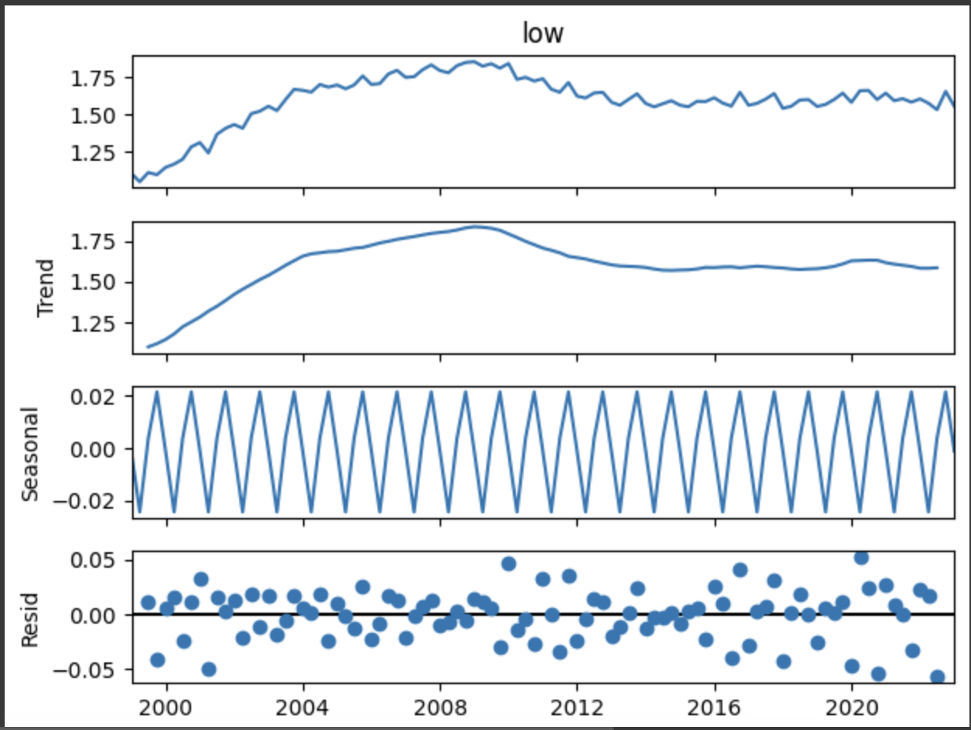
Seasonal Decomposition Analysis

Slide 12
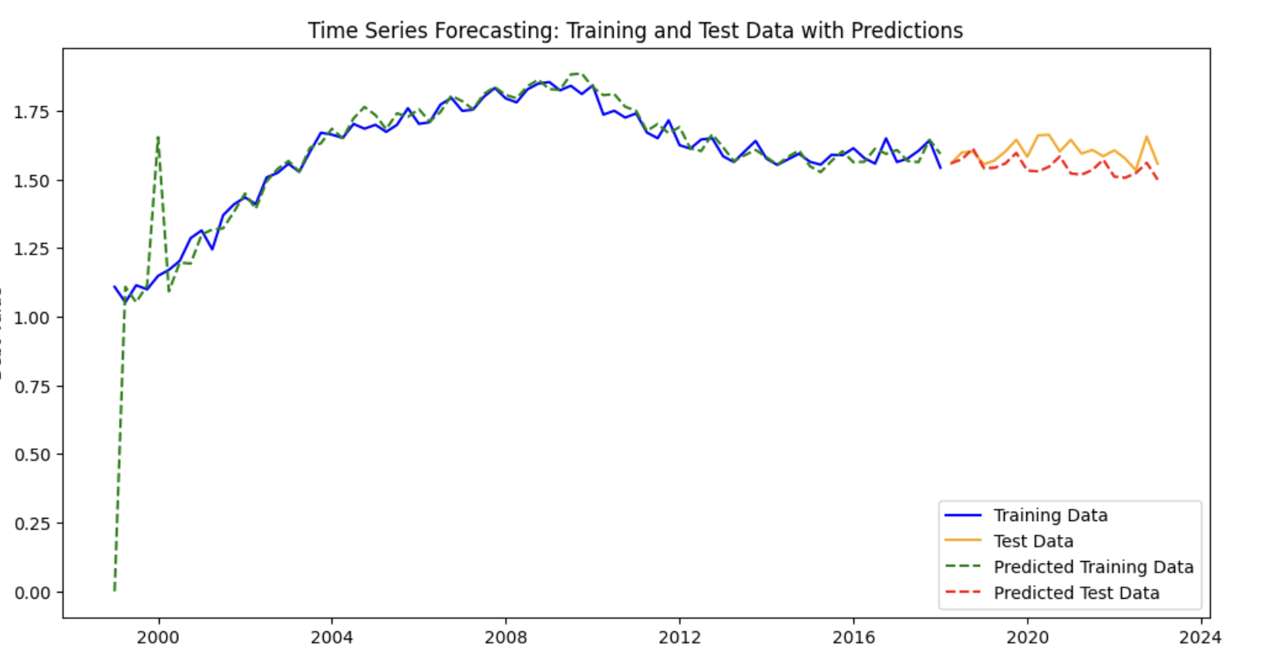
Time Series Analysis

Slide 13
The Results
Next Steps
Training MAE: 0.048
Training MAPE: 3.65%
TEST Mean Absolute Error (MAE): 0.055
TEST Mean Absolute Percentage Error (MAPE): 3.41%
Implement techniques like cross-validation to ensure that the model's performance is robust across different subsets of the training data.
Optimize PDQ parameters
Notes:
The relatively low MAE on the training data indicates that the model's predictions are, on average, about 0.0483 units away from the actual values in the training set. This suggests a good fit on the training data.
Training MAPE: 3.6504671403246816%
The MAPE of approximately 3.65% on the training set implies that the model's predictions are off by 3.65% from the actual values, on average. This is a reasonably low error percentage, suggesting that the model has captured the underlying patterns in the training data quite well.
Test MAE: 0.0551989235411686
The MAE on the test data is slightly higher than on the training data but still remains low. An average deviation of 0.0552 suggests the model has managed to generalize well, though slightly less effectively than on the training data.
Test MAPE: 3.411125803650962%
The MAPE on the test set is marginally lower than on the training set, indicating a good level of prediction accuracy. A MAPE of around 3.41% is generally considered good in many applications, showing that the model's predictive capability holds up well on unseen data.
###Interpretation:
The model demonstrates a good fit and reasonable predictive accuracy, as evidenced by the low MAE and MAPE values on both the training and test sets.
The slightly higher MAE on the test set compared to the training set is normal and suggests a modest amount of overfitting to the training data. However, the similar performance on both training and test sets suggests that the model is neither overfitting nor underfitting significantly.
—--------------
Simplify the model (use a model with fewer parameters or less complexity).
Use regularization techniques which add a penalty to the loss function to discourage complex models.
Increase the amount of training data, if possible.
Implement techniques like cross-validation to ensure that the model's performance is robust across different subsets of the training data.
Apply pruning techniques in certain types of models (like decision trees) to remove parts of the model that might be capturing noise.

Slide 14
Next steps
Predictions and Strategy Formulation
Convert FIPS Codes to County Names
Clustering Models
1
2
3
4
5
Merge Datasets
Optimize Models
Notes:
Use regularization techniques which add a penalty to the loss function to discourage complex models.
Increase the amount of training data, if possible.
Implement techniques like cross-validation to ensure that the model's performance is robust across different subsets of the training data.

